Slide 1
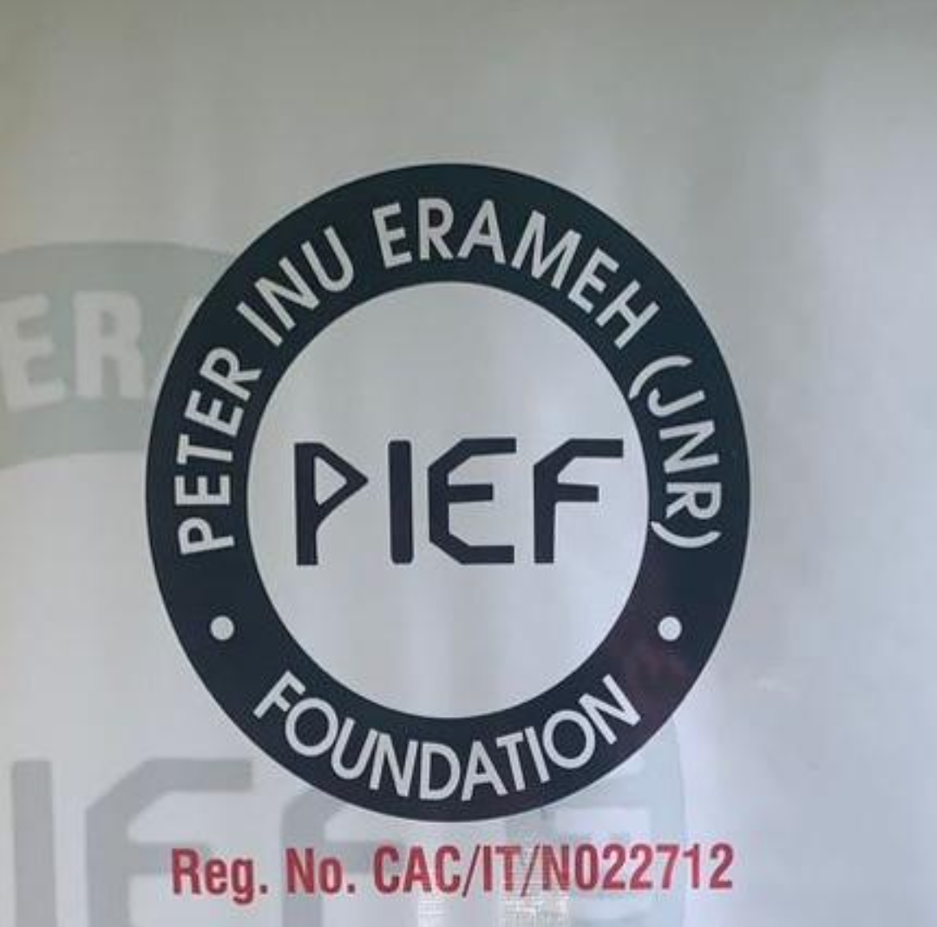
Harnessing Computer Application Packages and Artificial Intelligence (AI) for Future Innovation
Presented by Peter Inu Erameh (Jnr) Foundation.

Slide 2
Introduction
Good morning everyone! My name is Peter, and I’m here on behalf of Peter Inu Erameh (Jnr.) Foundation —an organization passionate about empowering young people with digital and tech skills for the future.”
Purpose of the seminar: to raise awareness about how computer applications and Artificial Intelligence can be used to drive innovation.
Importance of digital literacy in modern education and careers.

Slide 3
Understanding Computer Application Packages
Computer application packages are software programs designed to help us perform specific tasks efficiently.
Application Type | Common Tools | Uses
Word Processing | Microsoft Word, Google Docs | Writing letters, reports
Spreadsheets | Microsoft Excel, Google Sheets | Data analysis, budgeting
Presentation | PowerPoint, Google Slides, Canva | Creating slides for lessons or projects
Graphics | CorelDRAW, Photoshop, Canva | Designing posters, logos
Database | MS Access, MySQL | Storing and organizing information
Notes:
Discussion Prompt: “How many of you have used any of these tools before? What did you use them for?”

Slide 4
Introduction to Artificial Intelligence
“Artificial Intelligence (AI) refers to the ability of machines or computers to perform tasks that normally require human intelligence—like reasoning, learning, and problem-solving.”
Examples in Everyday Life:
Voice assistants (Siri, Alexa, Google Assistant)
Chatbots and customer service
Face recognition in phones
AI-generated art, writing, and design tools
Smart traffic systems and self-driving cars
Notes:
Short Activity: Show a quick demo (if possible) of ChatGPT or an AI image generator to show students how AI can create content.

Slide 5
Working Together for Innovation
“Computer application skills and AI tools complement each other.”
Using Excel with AI to analyze data faster.
Combining design software (like Canva) with AI to generate creative ideas.
Automating reports, presentations, and research using AI.
Notes:
“AI doesn’t replace creativity—it enhances it. It helps you do more, faster, and smarter.”

Slide 6



How AI and Computer Skills Drive Innovation
Case Studies:
Students using AI to design prototypes or models for science projects.
Entrepreneurs using spreadsheets and AI for business planning.
Engineers designing smart devices using computer-assisted tools.
Notes:
Inspiration Quote: “The future belongs to those who can imagine it, design it, and make it real—with the help of technology.”

Slide 7
How Students Can Get Started
Learn basic computer packages – start with Word, Excel, PowerPoint.
Take free online courses – platforms like Coursera, Khan Academy, or Code Academy.
Practice regularly – use what you learn for assignments or personal projects.
Explore AI tools – learn prompt writing, image generation, and automation.
Join tech clubs or communities – network with like-minded peers.

Slide 8
Conclusion & Q/A
Computer applications make you efficient.
AI makes you innovative.
Together, they empower you to become a creator—not just a consumer—of technology.
Notes:
Closing Remark: “At Code Academy, we believe every student has the potential to become a digital innovator. The tools are available—you just need to learn how to use them.”

Slide 9

Thank you!

